Slide 1

In-Context Learning Assisted Prompt Optimization in LLMs for Classification Tasks
By
Vaishnav Nigade
Guided By,
Dr. Sushil Kumar Joshi-IIITK,
‘Department of CSE

Slide 2
OUTLINE:
Introduction
Applications
Literature Review
Problem Statement
Objective of Our Project
Architecture
Methodology
Dataset
Future Work
Conclusion
References

Slide 3
Introduction
Growth of internet & social media → massive spread of misinformation.
Manual fact-checking is slow & impractical.
Existing ML/DL models: limited by redundancy & lack of transparency.
LLMs (e.g., ChatGPT) are powerful but:
Lack explainability
Depend on static prompts
Our project: Uses evolutionary algorithms + prompt optimization to improve fake news detection with better accuracy & interpretability.

Slide 4
Applications:
Social Media Platforms → Real-time detection of fake news on Twitter, Facebook, Instagram.
News Agencies & Journalism → Automated verification of news articles before publication.
Government & Policy Makers → Identifying misinformation campaigns, enhancing public trust.
Education & Awareness → Tools for students, researchers, and citizens to evaluate content credibility.
Cybersecurity → Preventing spread of propaganda, scams, and phishing attempts.
Business & Brands → Protecting reputation by detecting fake narratives or false claims.

Slide 5
Literature Review:
 | Paper Title | Journal | Methodology | Future Work & Gap
1 | Fake news detection via knowledgeable prompt learning | Information Processing & Management, 2022 | Proposed KPL, which integrates external knowledge into prompt learning for better fake news detection. | Broader dataset testing, improved knowledge integration, efficiency/scalability challenges.
2 | Adversarial Contrastive Learning for Evidence-Aware Fake News Detection With Graph Neural Networks | IEEE Transactions on Knowledge and Data Engineering | Models claim + evidences as graphs, learns long-range semantics with GNNs, prunes redundancy via graph structure learning. | Not explicitly stated; implied directions include scaling to broader datasets, strengthening evidence retrieval, and exploring alternative graph structure /contrastive objectives.
3 | Feature selection and multi-task learning with knowledge transfer | Information Sciences (Elsevier) | Comprehensive taxonomy linking feature selection with multi-task learning and knowledge transfer; synthesizes methods, applications, and performance trends. | Highlights open challenges: scalable FS under task relatedness, reliable transfer, and standardized evaluation across tasks

Slide 6
Literature Review:
 | Paper Title | Journal | Methodology | Future Work & Gap
4 | FNED: A Deep Network for Fake News Early Detection on Social Media. | ACM Transactions on Information Systems | Models early propagation as a sequence of status-sensitive crowd responses (text + user profile), feeds them to a CNN with position-aware attention and multi-region mean pooling, and uses a PU-Learning loop for scarce labels. | Broaden real-world validation and datasets, strengthen early-stage signals and user/structure features, and refine the PU-Learning/attention pipeline for robustness.
5 | Fake news detection in multiple platforms and languages. | Expert Systems with Applications | Text-only, platform/language-agnostic features evaluated across five datasets (English/Portuguese/Bulgarian); compare custom features, TF–IDF BoW, Word2Vec, and DCDistance with NB/KNN/SVM/RF; guard against leakage on Twitter via leave-topic-out CV; | Broaden multilingual/platform coverage, standardize evaluation, and explore stronger/text representations beyond current feature sets.

Slide 7
Problem Statement
Task: Decide whether a given news article is Real or Fake from its text (headline/body) using LLMs.
Challenges: Current LLM judgments can be brittle, hallucinate, and vary with prompt wording, reducing trust.
Requirement: Achieve accurate, evidence-grounded, and template-stable predictions within practical cost/latency limits, across topics and writing styles

Slide 8
Objective of Our Project:
To design and implement an end-to-end, feature-aware LLM pipeline for classification, spanning feature extraction, reliability (outlier) filtering, evolutionary (genetic) feature selection, and structured prompt engineering, to deliver reliable, transparent, and cost-efficient Real/Fake decisions suitable for practical deployment.

Slide 9
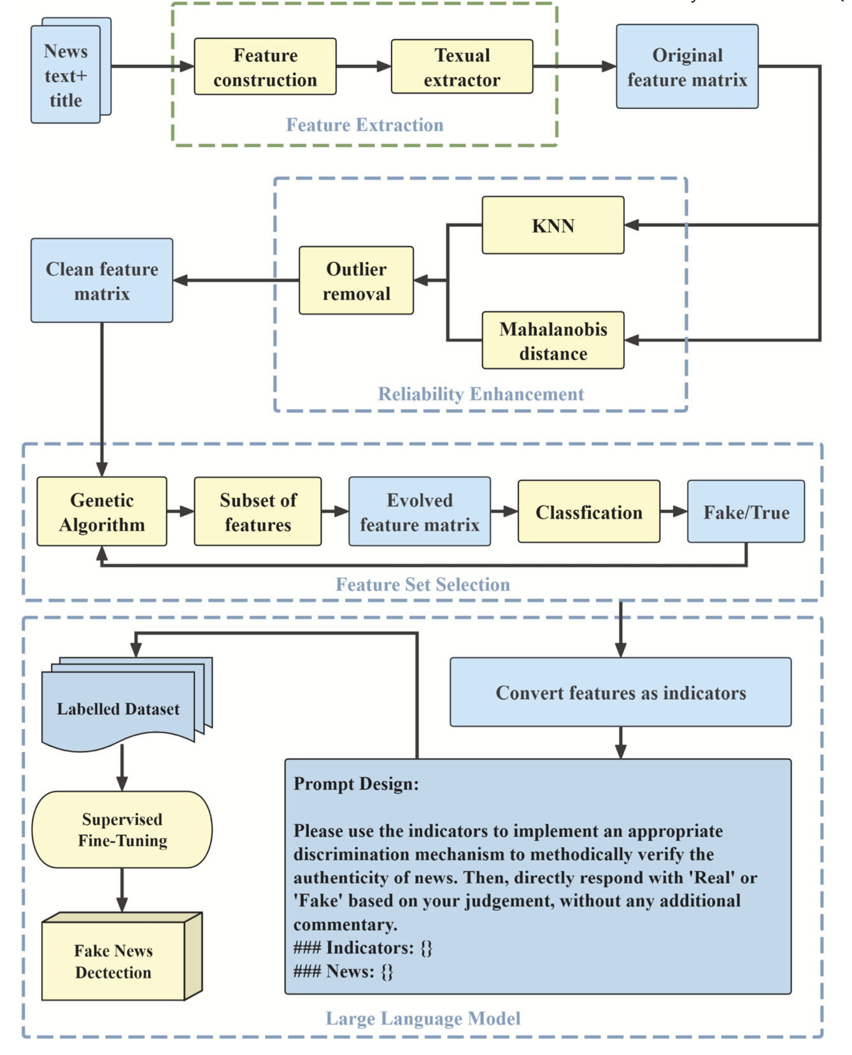
Architecture:
Ingestion → Feature Extraction → Outlier Removal → Evolutionary Feature Selection
Prompt Toolkit → In-Context Learning → LLM Head → Verdict

Slide 10
Methodology:
Compute indicators (readability, affect, nonfluency, entity types).
Filter outliers in feature space (Mahalanobis + KNN).
Run EFSA (genetic) to select a compact, explainable subset.
Build prompt fields from selected indicators .
Choose prompting schema and template strategy (single/selection/ensemble).
Inference: Indicators → Verdict with label-only output rules.

Slide 11
Methodology I: Preprocessing & Reliability
Compute indicators: readability, affect, nonfluency, entity types, etc.
Outlier removal (train-time): Mahalanobis + KNN on feature space to reduce noise.
Outputs: cleaned text + stable indicator set → fed to EFSA.
Ablation (planned): with/without outlier removal.

Slide 12
Methodology II: EFSA (Genetic Feature Selection)
Chromosome: feature subset; Fitness: validation macro-F1 (fixed prompt schema).
Ops: selection / crossover / mutation; early-stop on no-improvement.
Result: compact, explainable subset of indicators → drives prompt fields.
Ablation : full features vs EFSA subset.

Slide 13
Dataset Used:
 | Dataset Source | PolitiFact
1 | Type of Dataset | Political news articles fact-checked by experts.
2 | Structure | Tabular (CSV): news (text), label (binary)
3 | Availability | Public (via Fake NewsNet).
4 | Used Best For: | Fake news detection in political contexts.
5 | Label Scheme: | Binary: '0' (False/Fake), '1' (True/Real)

Slide 14
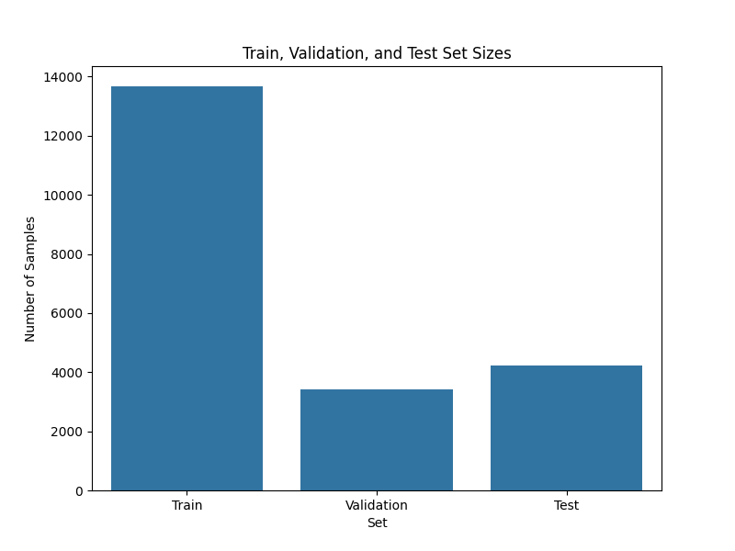
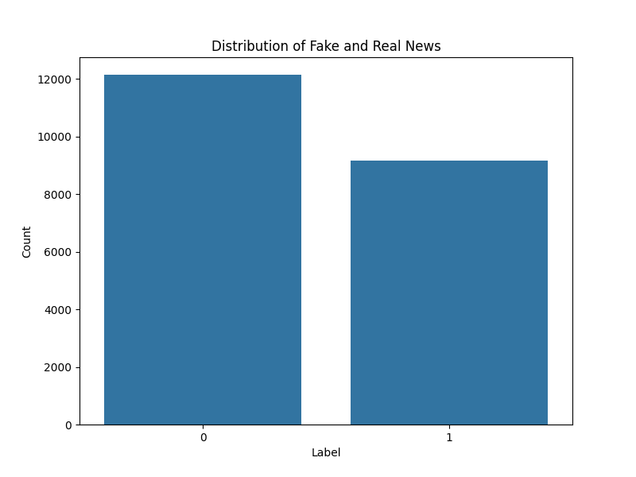
Dataset & Train, Validation, Test Splits
Train Rows: 17089 ; Train: 80%; Validation: 20%
Test Rows: 4227

Slide 15
Support Vector Machine (SVM) Model
Separates Real vs Fake news using the best-fit hyperplane
Maximizes margin between the two classes for better generalization.
Uses key text features/indicators to form the decision boundary.
Support vectors determine the final classifier.
Performs well in high-dimensional text data.

Slide 16
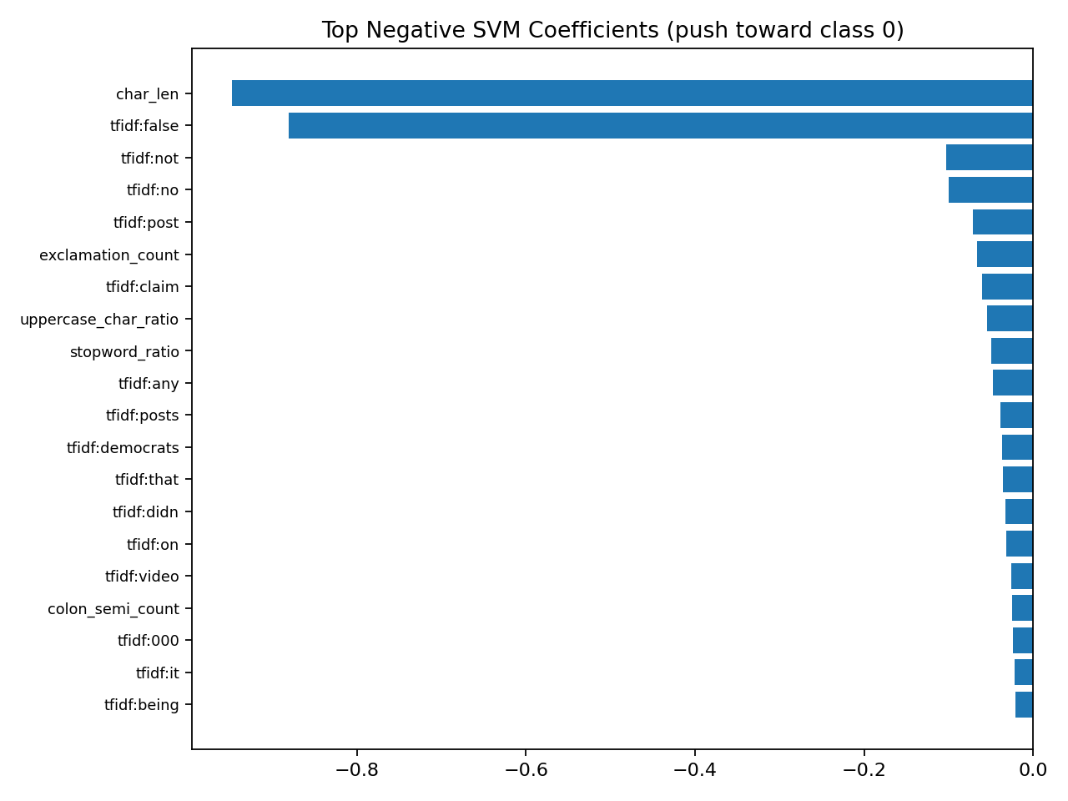
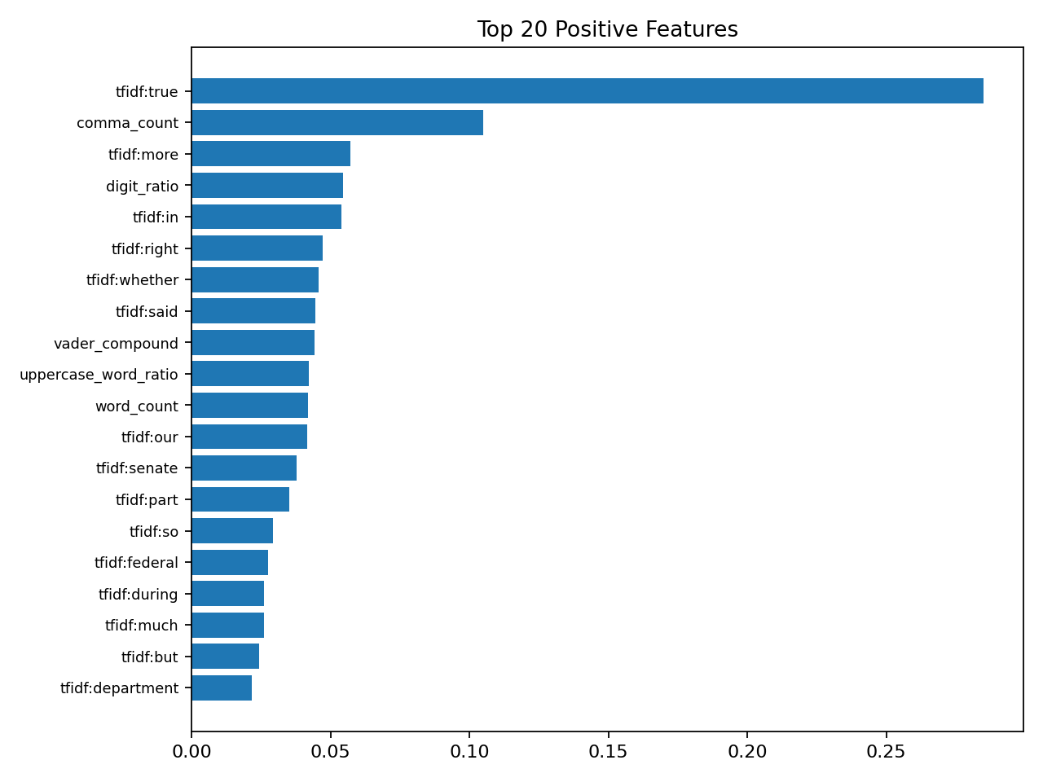
SVM Model Features Analysis
Top Negative SVM Features
Top Positive SVM Features

Slide 17
Random Forest Model
Ensemble model combining multiple decision trees.
Each tree learns from a random subset of data and features.
Final prediction made using majority voting across trees.
Handles non-linear patterns and noisy data effectively.
Reduces overfitting compared to single decision trees.
Performs well with text-derived indicators/features.

Slide 18
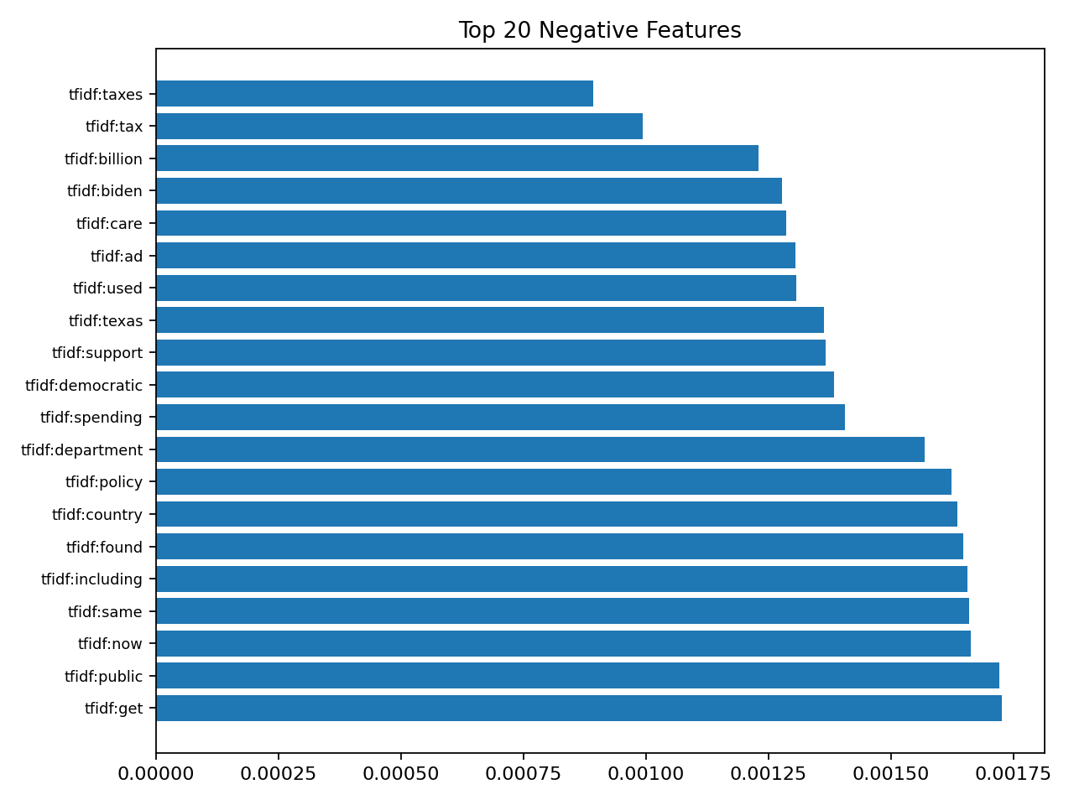
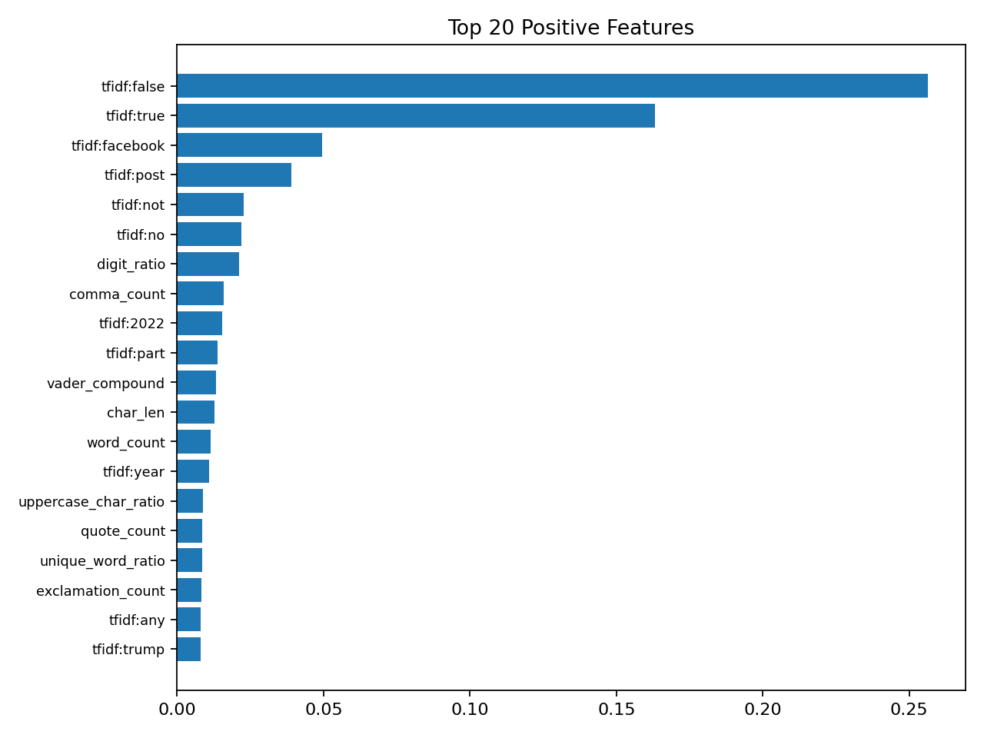
Random Forest Model Features Analysis
Top Negative Random Forest Features
Top Positive Random Forest Features

Slide 19
XGBoost Features Analysis
Uses gradient boosting to iteratively improve weak decision trees.
.Highlights top positive features strongly linked with Fake news indicators.
Highlight top negative features associated with real/Trustworthy news signals.
Handles non-linear patterns and complex interactions effectively.
Provides clear interpretability through gain, weight, and cover metrics.

Slide 20
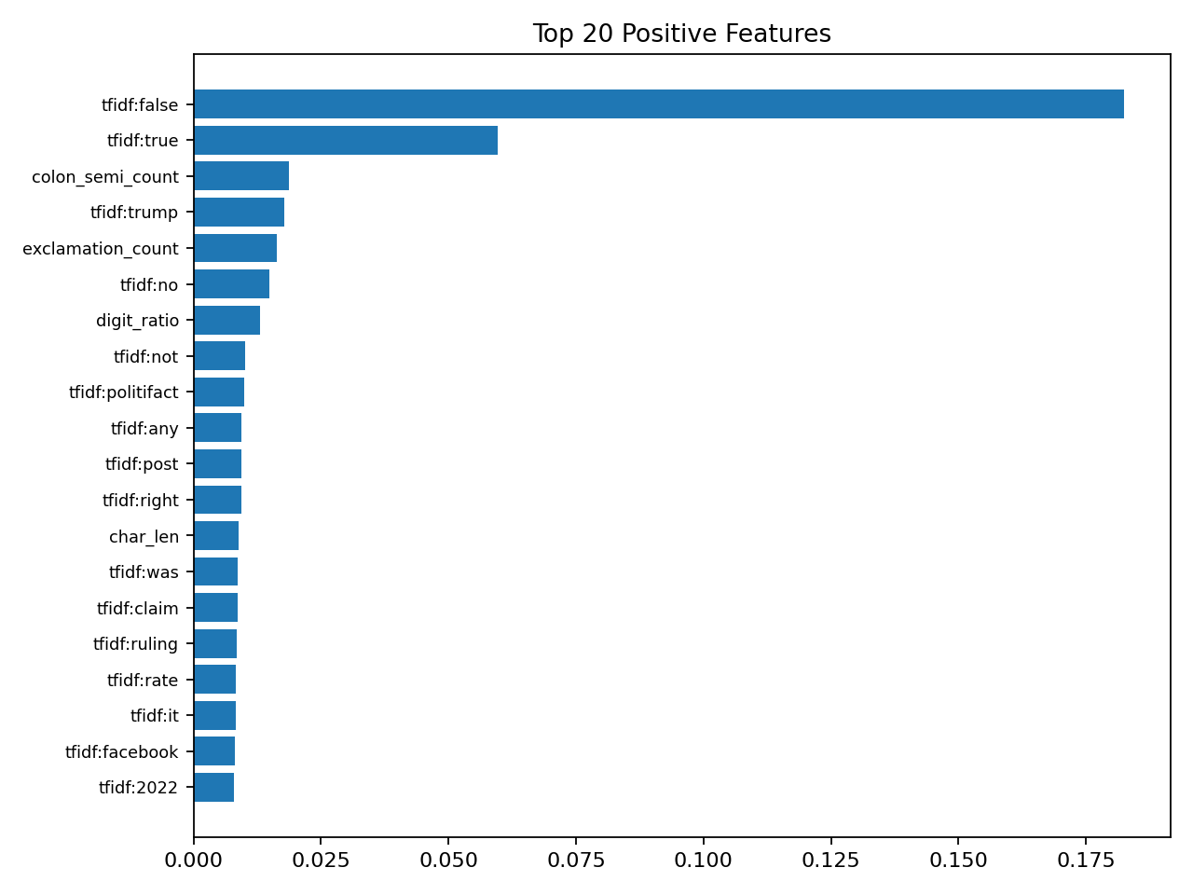
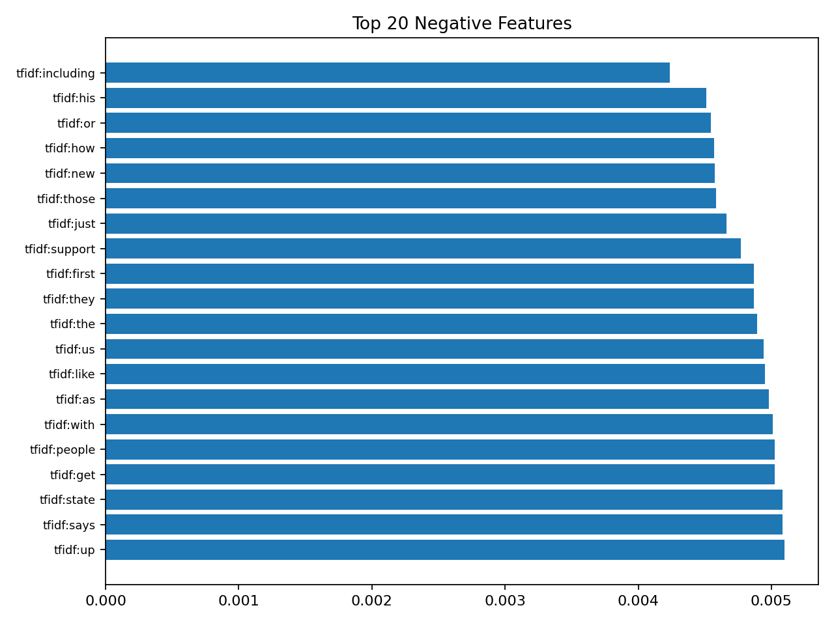
XGBoost Features Analysis
Top Negative XGBoost Features
Top Positive XGBoost Features

Slide 21
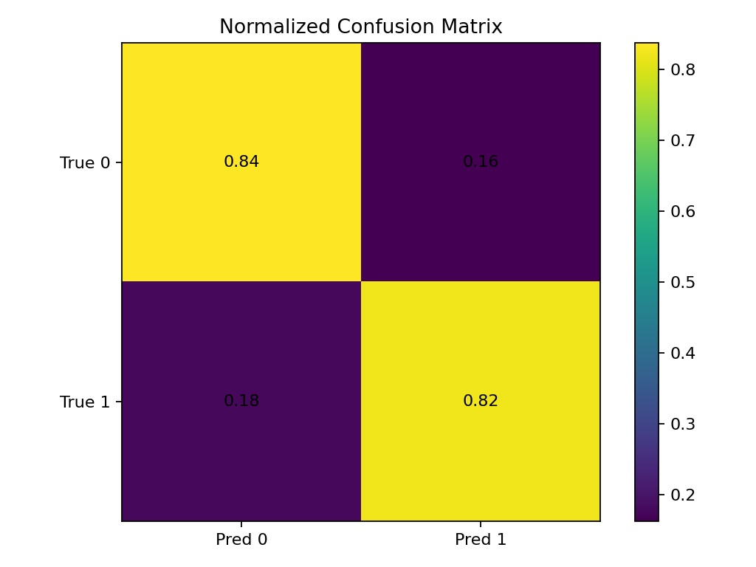
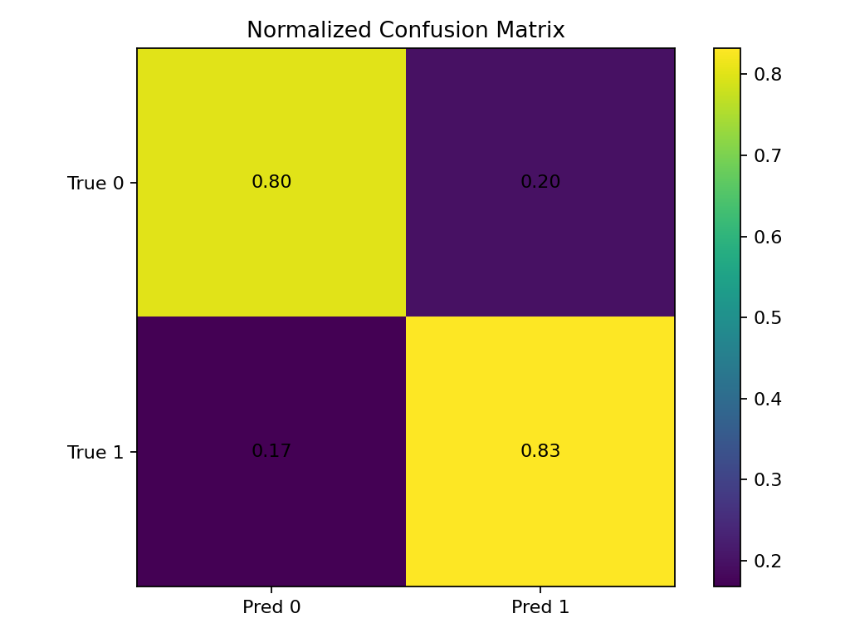
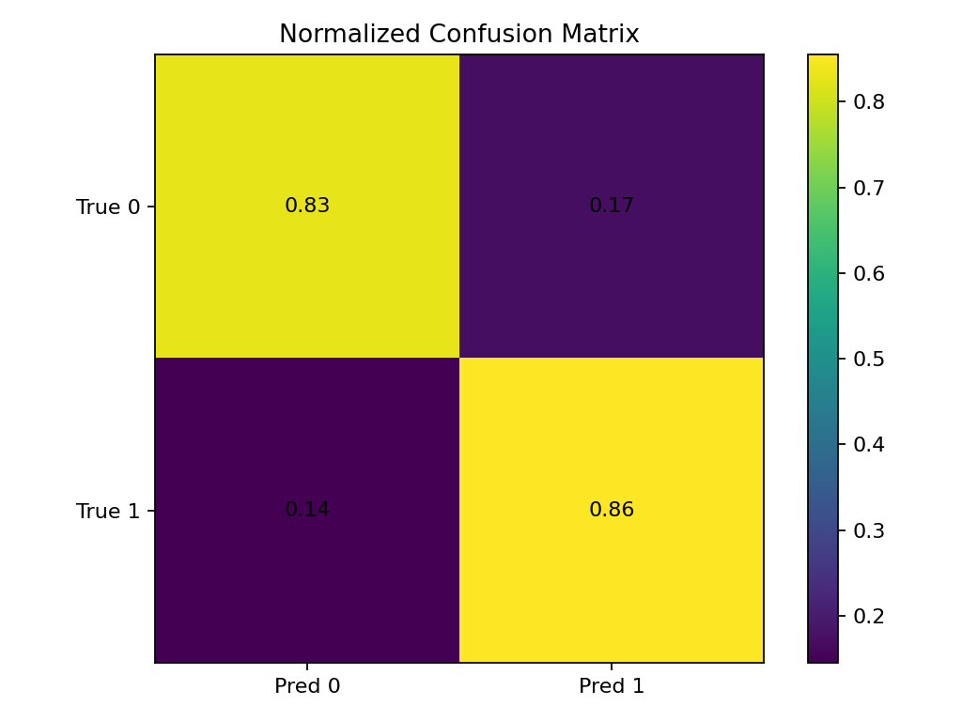
Model Results
Random Forest
SVM
XGBoost
XGBoost demonstrated the highest accuracy among the three models.

Slide 22
Future Work
LLM with Feature-Augmented Prompting:
Objective: To move beyond traditional models and utilize an LLM for classification, guided by our proven feature selection.
Method:
Instead of just providing raw text, we will construct a feature-augmented prompt.
The prompt will include the original text and explicitly list the top positive (deceptive) and negative (truthful) features identified by our Genetic Algorithm that are present in that text.
Expected Outcome: By providing these features as clear "indicators," we guide the LLM's reasoning process, enabling it to focus on the most salient signals of deception and significantly improve prediction accuracy.

Slide 23

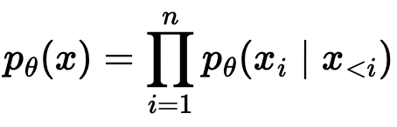
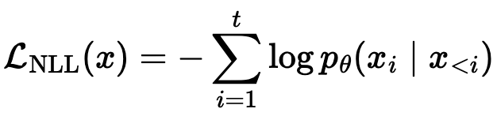
How LLMs work
Let the token sequence be:
The model defines a probability over the whole sequence by chaining next-token probabilities:
Training minimizes negative log-likelihood (next-token prediction loss):

Slide 24
Advanced Enhancement with In-Context Learning
Objective:
To further refine the LLM's predictive power by enabling it to learn from examples on-the-fly.
Method:
We will enhance our prompts by providing a few complete examples a technique known as In-Context Learning.
Each prompt will contain the target text (with its feature indicators) plus 1-2 examples of clearly deceptive text and 1-2 examples of clearly truthful text, also presented with their key feature indicators.
Expected Outcome: This allows the LLM to recognize complex patterns and adapt its classification strategy in real-time, boosting performance and robustness without requiring costly model fine-tuning.

Slide 25


How In-Context Learning works
Let previous examples (demos) be:
At test time we give the demos + a new input in the prompt. The model predicts a distribution over outputs:

Slide 27
Recap: Problem Setting & Motivation
Rapid spread of fake news on social media makes manual verification infeasible.
Traditional ML/DL models:
Depend on handcrafted features
Often lack robustness and interpretability
LLMs are powerful but:
Sensitive to prompt wording
Rely on static prompts
Key idea so far: Build a reliable, feature-driven pipeline before introducing LLMs.

Slide 28
Recap: Methodology & Pipeline Implemented
Feature Extraction:
Linguistic style, text complexity, psychological & affective indicators
Reliability Enhancement:
Outlier removal using Mahalanobis Distance + KNN
Evolutionary Feature Selection (EFSA):
Genetic Algorithm selects a compact, informative feature subset
Optimizes performance while improving interpretability
Classical Models Evaluated:
SVM, Random Forest, XGBoost

Slide 29
Dataset Used:
 | Dataset Source | PolitiFact
1 | Type of Dataset | Political news articles fact-checked by experts.
2 | Structure | Tabular (CSV): news (text), label (binary)
3 | Availability | Public (via Fake NewsNet).
4 | Used Best For: | Fake news detection in political contexts.
5 | Label Scheme: | Binary: '0' (False/Fake), '1' (True/Real)

Slide 30
Model Results
Random Forest
SVM
XGBoost
XGBoost demonstrated the highest accuracy among the three models.

Slide 31
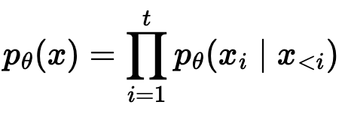
How LLMs work
Let the token sequence be:
The model defines a probability over the whole sequence by chaining next-token probabilities:
Training minimizes negative log-likelihood (next-token prediction loss):

Slide 32
Base Model
Model used: microsoft/phi-2
Size: 2.7B parameters
The Context:
This model was pre-trained on massive amounts of internet text.
Not trained specifically for fake-news classification
The Goal: We need Fine-Tuning to adapt this general knowledge to our specific classification task.

Slide 33
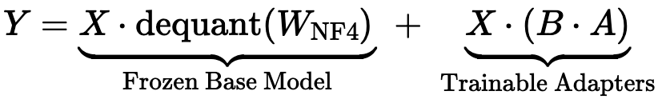
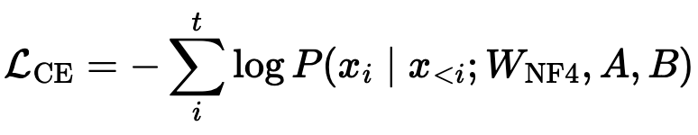
LLM Fine-Tuning Strategy (Recap)
Base Model: Phi-2 (2.7B)
Parameter-efficient fine-tuning using QLoRA
Frozen 4-bit quantized base weights
Trainable low-rank adapters
Mathematical Formulation

Slide 34
Why In-Context Learning (ICL)?
Limitations of the Fine-Tuned LLM
Relies only on learned parameters from training data.
Performance may degrade on ambiguous or unseen news articles.
Sensitive to prompt variations and contextual nuances.
Motivation for ICL
Enables the model to learn from examples at inference time.
Provides task-specific guidance without retraining.
Enhances robustness and adaptability.

Slide 35
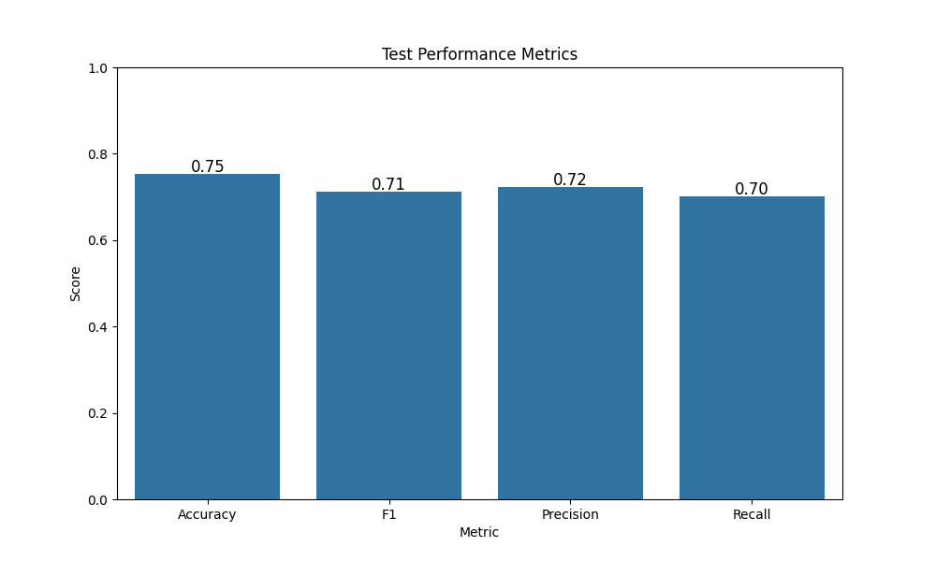
Results
Model: microsoft/phi-2 (2.7B)
Fine-tuning: QLoRA
Dataset: Politifact
Accuracy: 75%
Train: 13,468 (Real: 7658, Fake: 5810)
Test: 4,228 (Real: 2399, Fake: 1829)

Slide 36

In-Context Learning (ICL) Intro
Definition: In-Context Learning (ICL) adapts the LLM to a task without updating weights, by providing examples + retrieved context inside the prompt.
Prompt structure (context + demonstrations + query):
Prediction with ICL:
Key point: Only the input context changes, model parameters θ stay fixed.

Slide 37



Retrieval Setup
We have a database of news items:
For a query article qq, retrieval selects top-kk items:
These retrieved items become ICL demonstrations in the prompt:

Slide 38

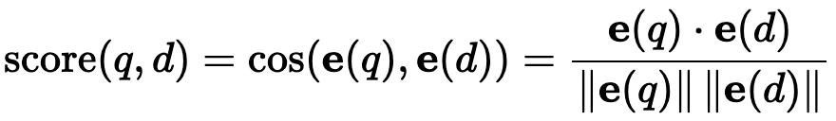
Dense Retrieval (Embeddings – multi-qa-MiniLM)
Approach
Converts text into dense semantic vectors using a transformer-based embedding model.
Captures contextual similarity beyond exact keyword matches.
Mathematical Formulation
Key Advantage
Retrieves semantically similar news articles even when wording differs.

Slide 39
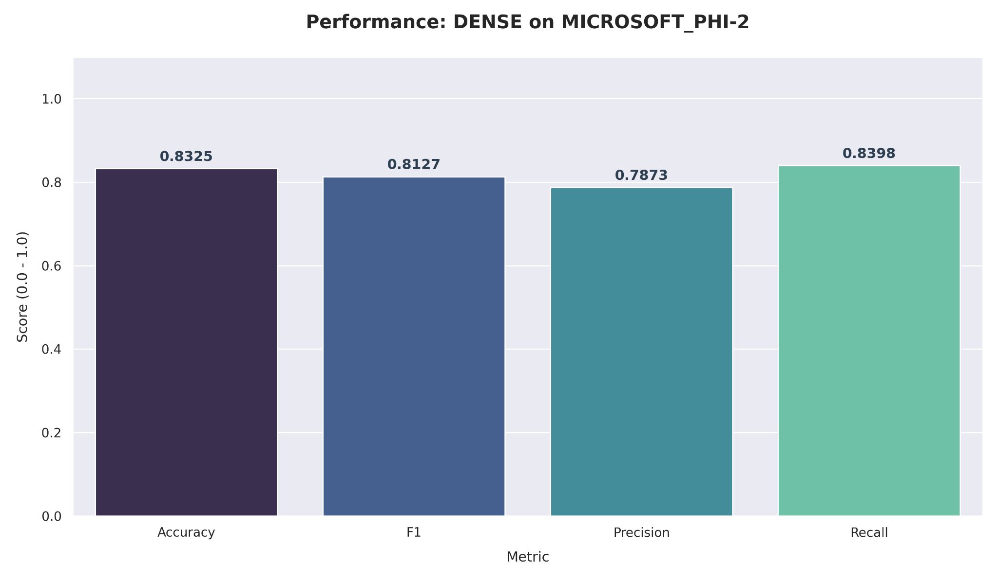
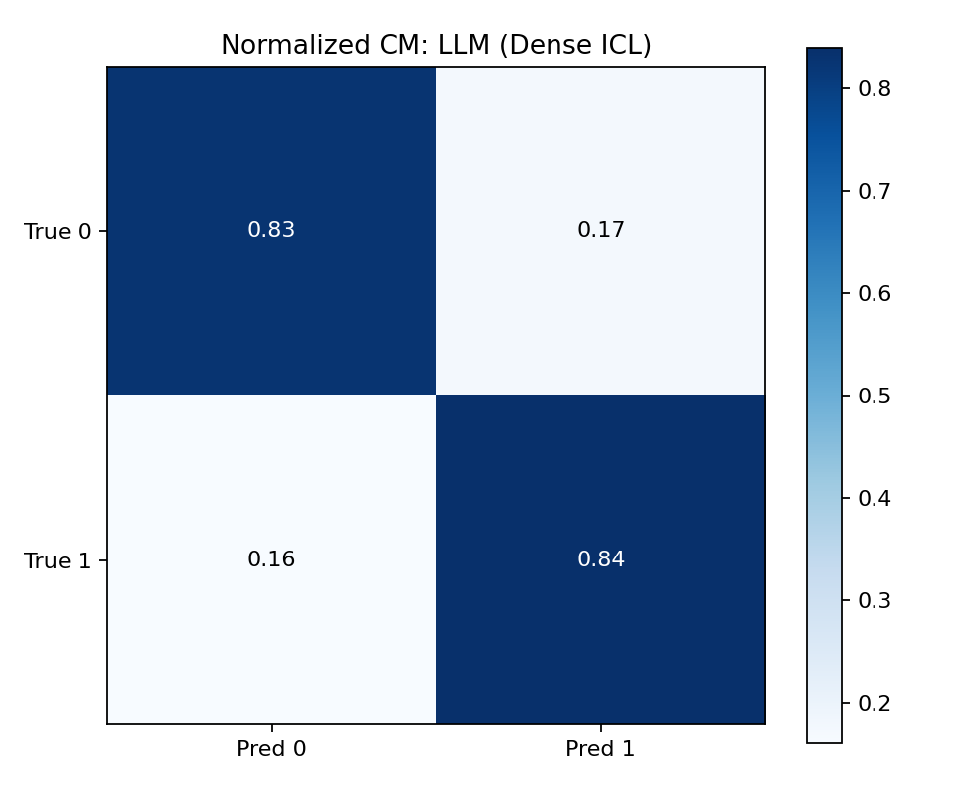
Dense Retrieval Result Analysis

Slide 40
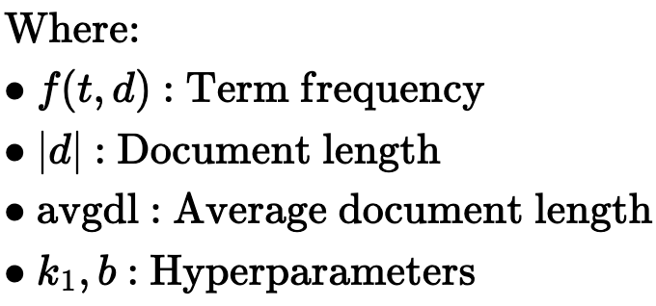
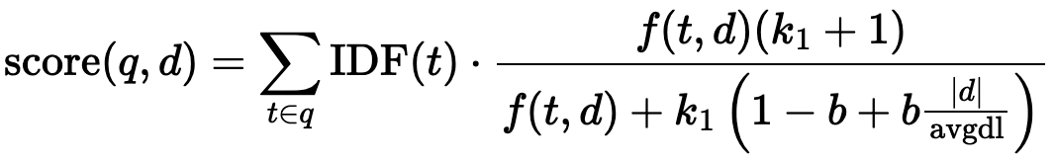
2. BM25 Retrieval (Lexical Matching)
Approach
A probabilistic ranking algorithm based on term frequency and inverse document frequency.
Effective for exact keyword matching.
Mathematical Formulation
Key Advantage
Strong baseline for traditional information retrieval tasks.

Slide 41
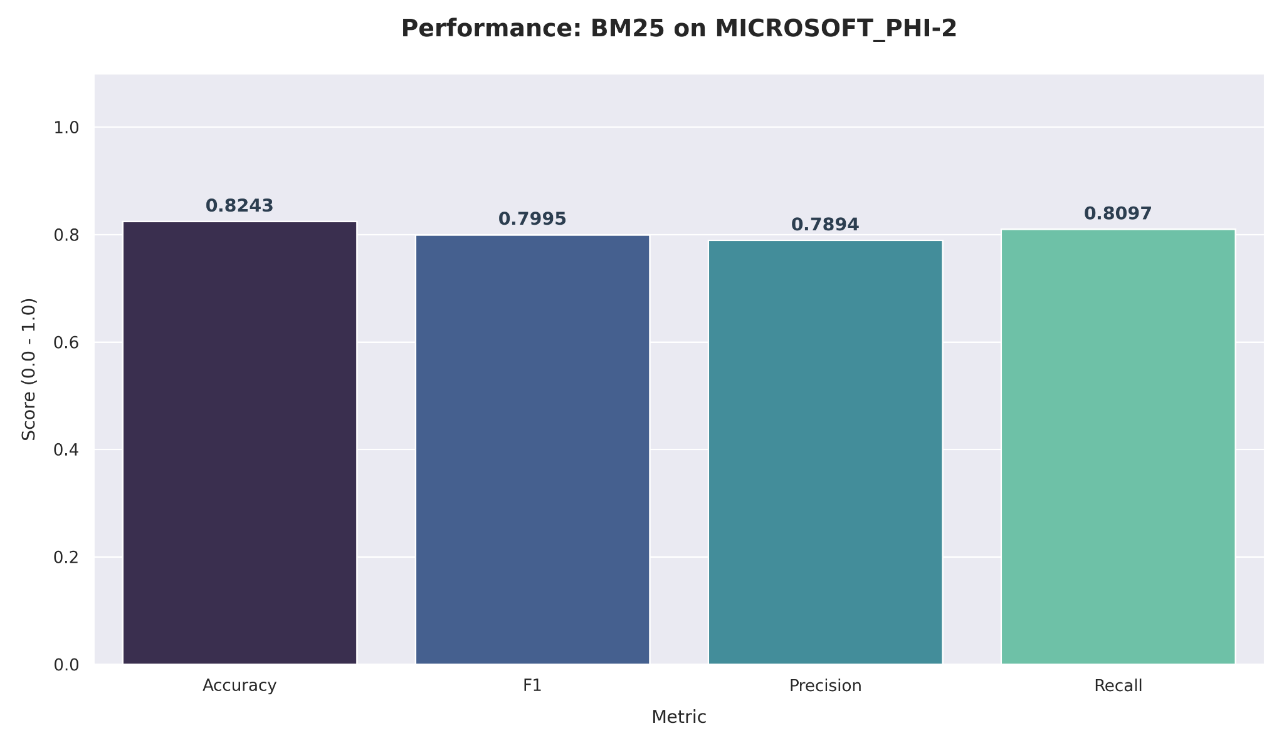
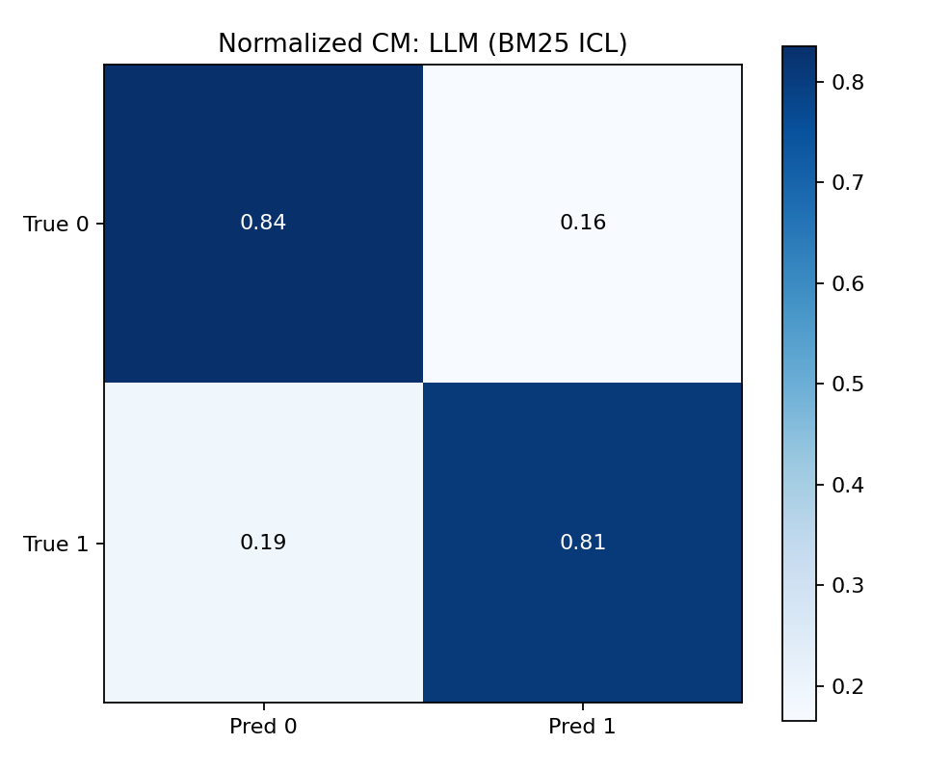
BM25 Retrieval Result Analysis

Slide 42
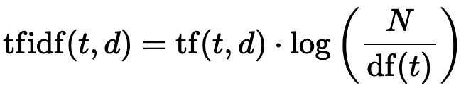


3. TF-IDF Retrieval (Vector Space Model)
Approach
Represents documents using term importance based on frequency and rarity.
Provides a lightweight and interpretable baseline.
Mathematical Formulation
Key Advantage
Simple, fast, and computationally efficient.

Slide 43
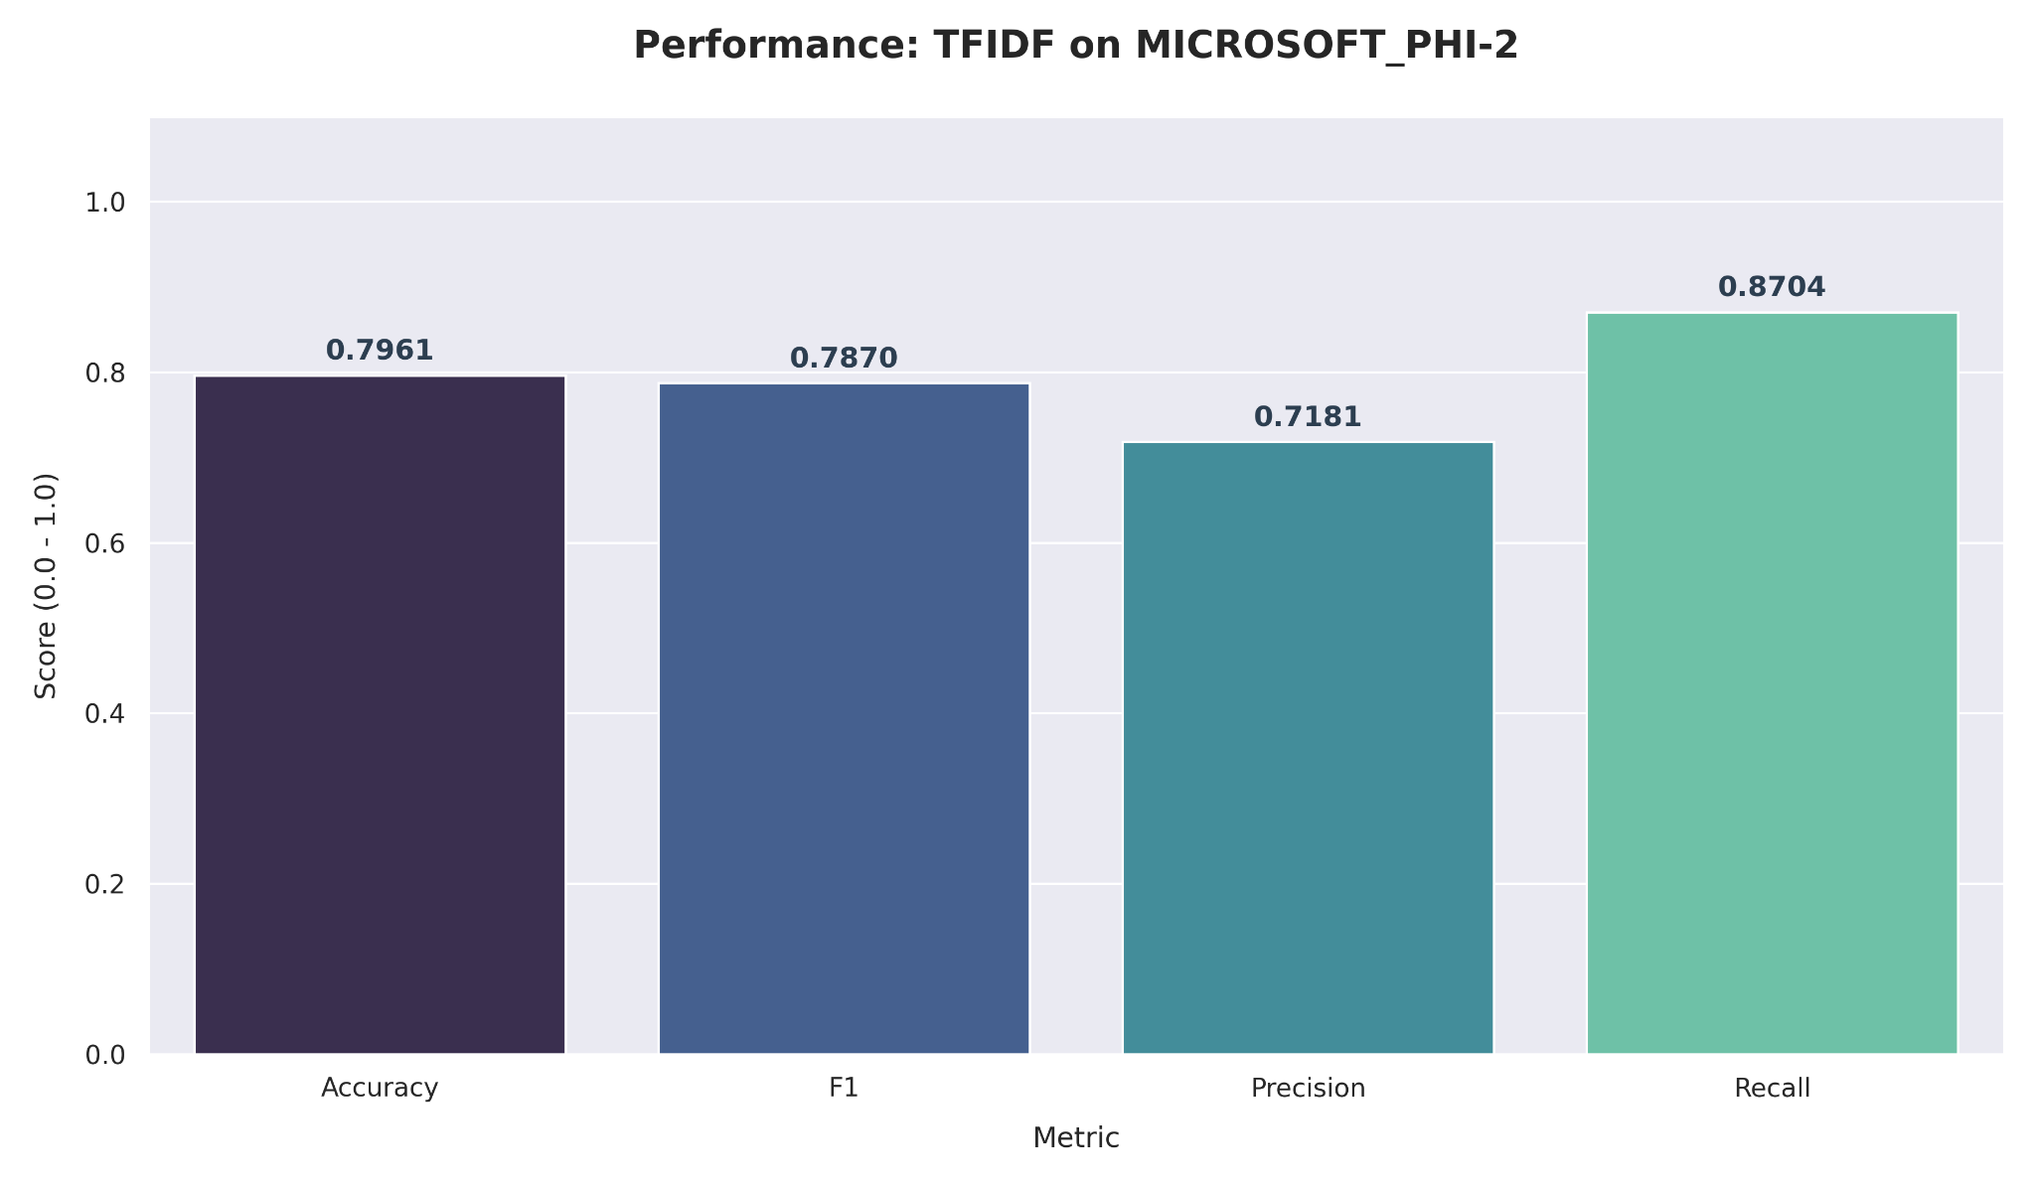
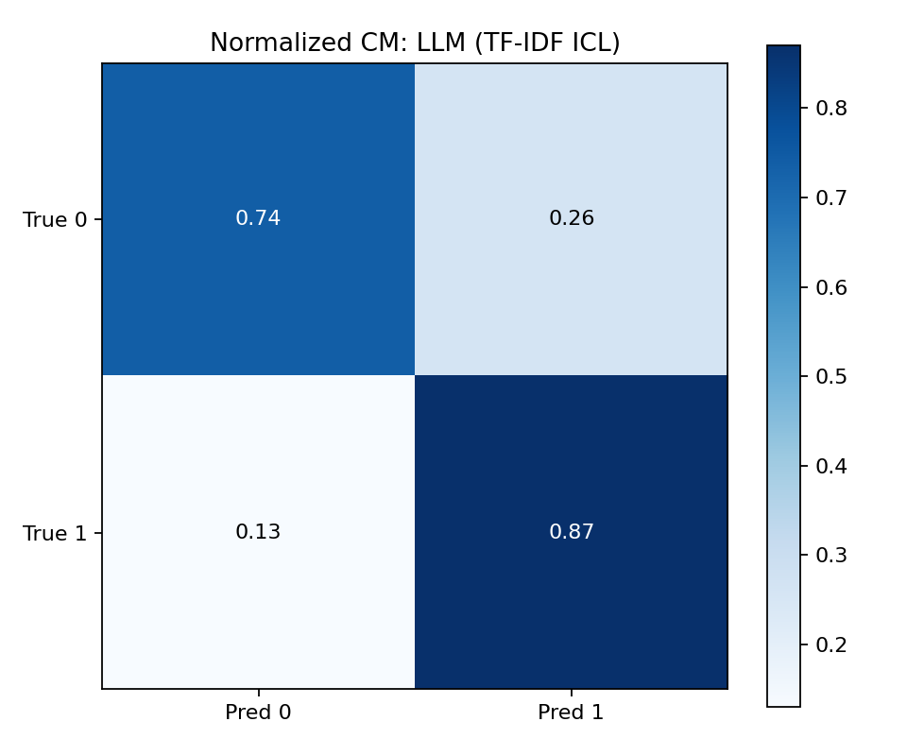
TF-IDF Retrieval Result Analysis

Slide 44


4. SBERT Retrieval (Sentence-Level Transformer Embeddings)
Approach
Uses Sentence-BERT to generate semantically meaningful sentence embeddings.
Designed specifically for similarity and retrieval tasks.
Mathematical Formulation
Key Advantage
Captures deeper semantic relationships than TF-IDF and BM25.

Slide 45
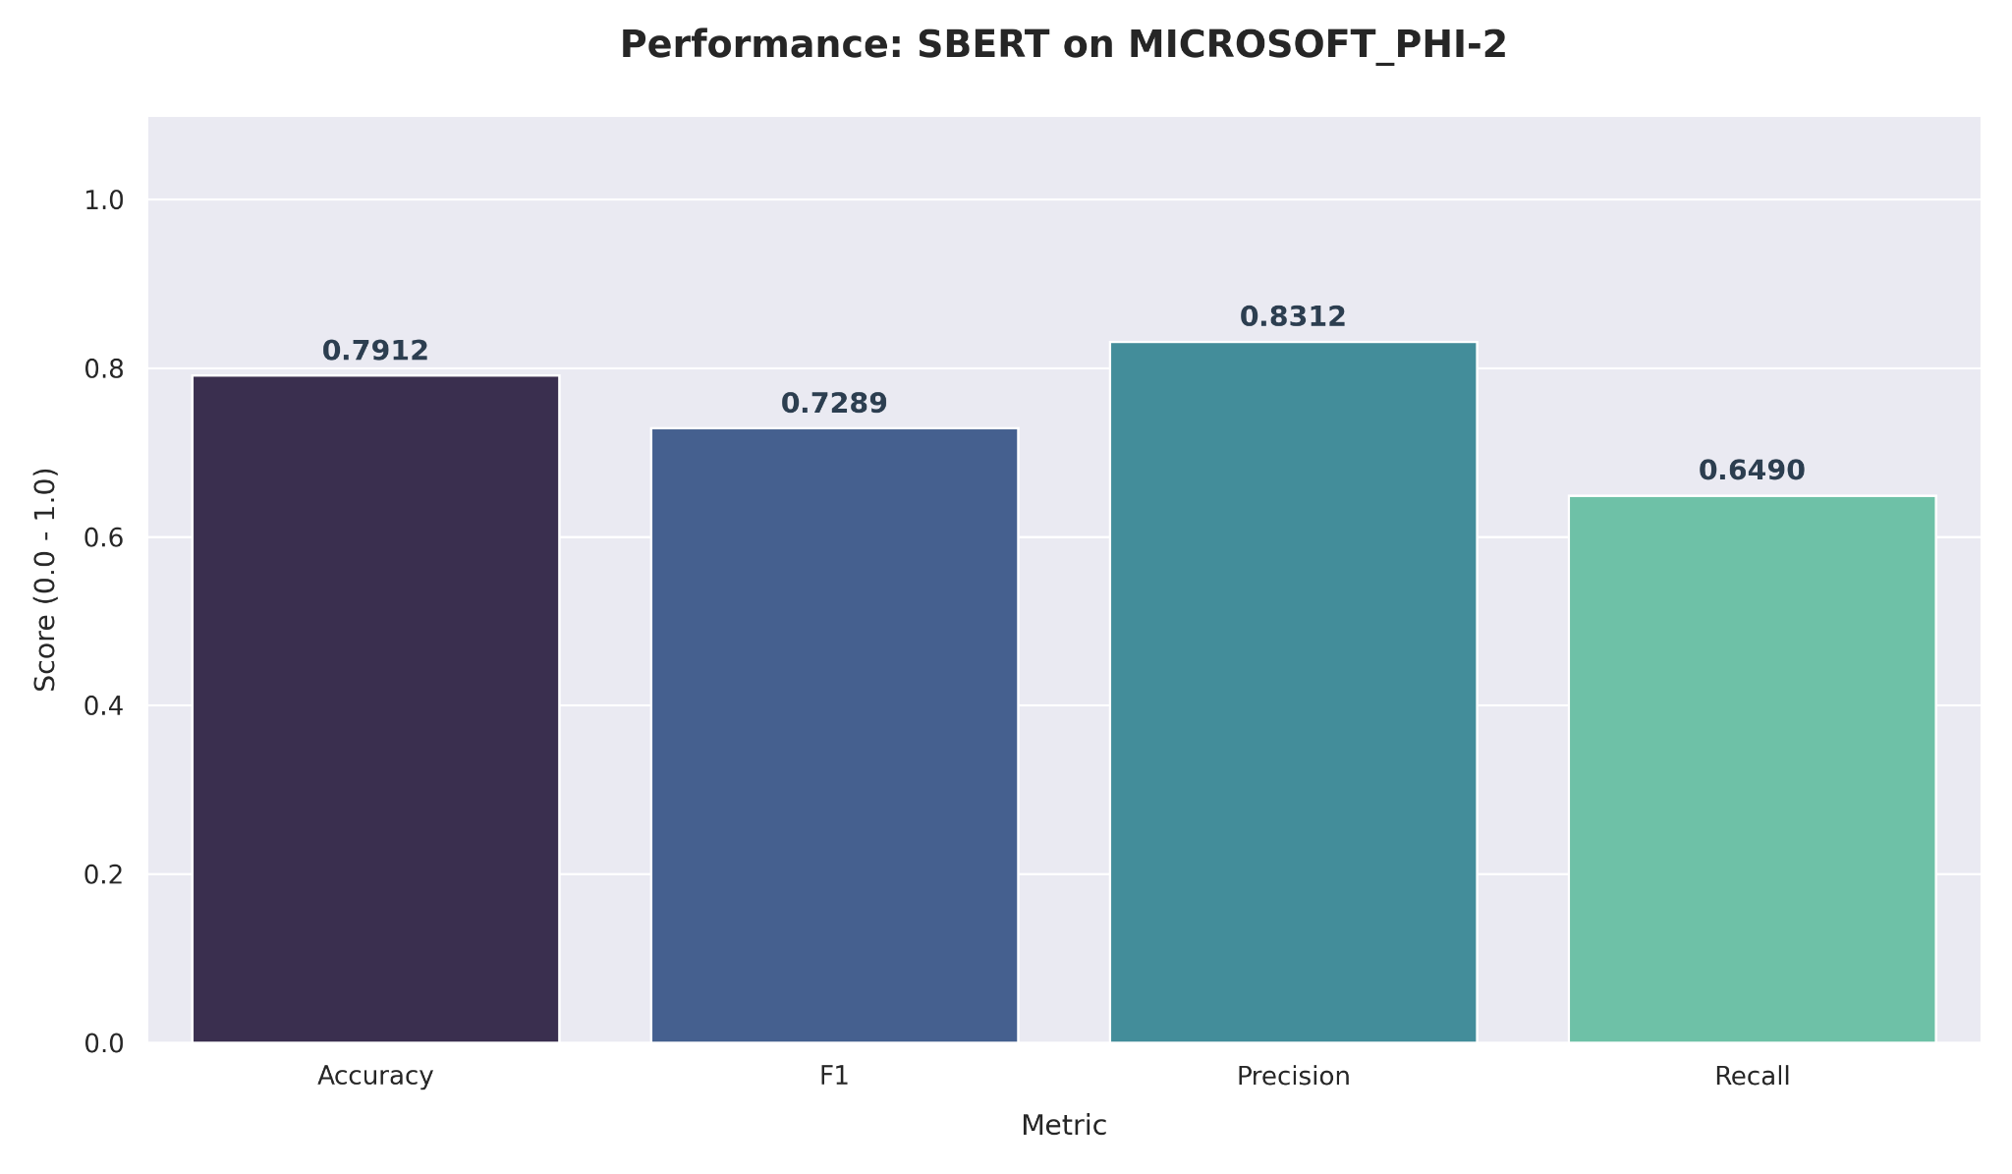
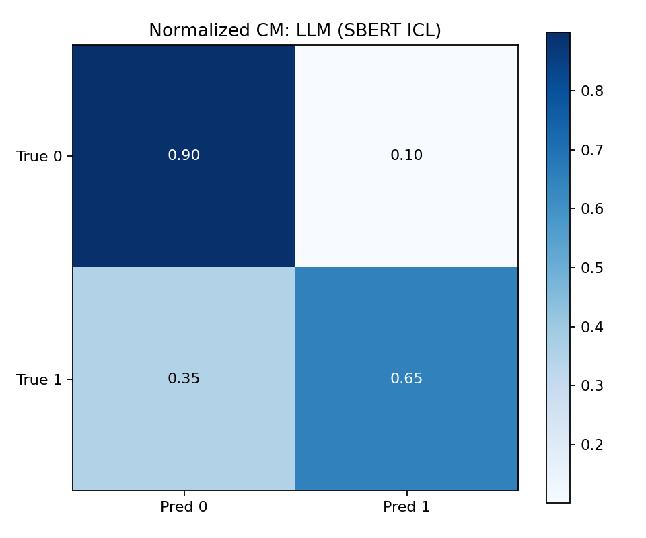
SBERT Retrieval Result Analysis

Slide 46
Classical baselines + all ICL methods Results
Model | Scenario | Accuracy | Precision | Recall | F1
SVM | Baseline | 0.8158 | 0.7636 | 0.8316 | 0.7961
Random Forest | Baseline | 0.8247 | 0.7878 | 0.8141 | 0.8008
XGBoost | Baseline | 0.8394 | 0.7946 | 0.8480 | 0.8204
LLM (Phi-2) | QLoRA | 0.75 | 0.71 | 0.72 | 0.71
 | Dense ICL + QLoRA | 0.8325 | 0.7873 | 0.8398 | 0.8127
 | BM25 ICL + QLoRA | 0.8243 | 0.7894 | 0.8097 | 0.7995
 | TF-IDF ICL + QLoRA | 0.7961 | 0.7181 | 0.8704 | 0.7870
 | SBERT ICL + QLoRA | 0.7912 | 0.8312 | 0.6490 | 0.7289

Slide 47
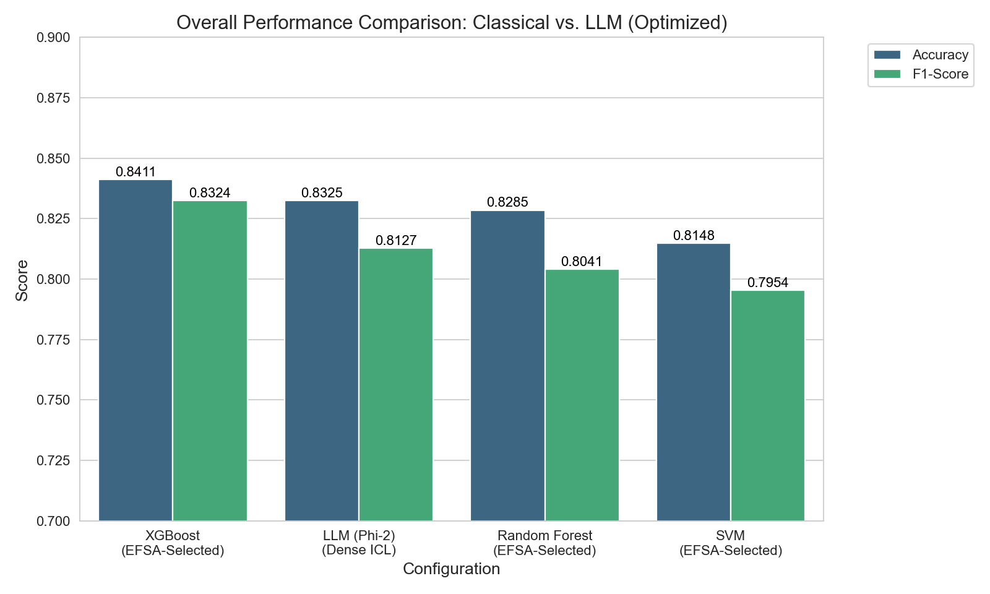
Final Result
XGBoost achieves the highest Accuracy and F1-Score.
Phi-2 with Dense ICL performs close to the best classical setup.
Random Forest and SVM trail behind in both metrics.
The results show that optimized LLMs can approach classical model performance.

Slide 48
Future Work
Explore larger instruction-tuned LLMs (e.g., Phi-3, LLaMA variants)
Improve retrieval strategy using hybrid (lexical + semantic) scoring
Optimize number of retrieved examples (adaptive top-k selection)
Investigate real-time deployment and latency optimization

Slide 49
Conclusion
We extracted linguistic and psychological indicators from news text to construct feature-augmented prompts for reliable fake news detection.
Using these indicators, we fine-tuned the Phi-2 Large Language Model with QLoRA, achieving efficient and cost-effective adaptation with an accuracy of 75%.
To further enhance performance, we integrated In-Context Learning (ICL) by retrieving relevant labeled examples using multiple retrieval techniques such as Dense Retrieval, BM25, TF-IDF, and SBERT.
Experimental results demonstrate that ICL improves robustness and contextual understanding, with Dense Retrieval providing the most effective context for classification.
Overall, the proposed pipeline combines feature engineering, parameter-efficient fine-tuning, and retrieval-augmented prompting to deliver accurate, interpretable, and scalable fake news detection.

Slide 50
References
[1] L. Wu, X. Yang, X. Shi, and C. Ma, "Optimizing prompt efficacy in large language models for fake news detection via evolutionary algorithm-based feature selection," Information Sciences, vol. 720, 2025.
[2] J. White, Q. Fu, S. Hays, M. Sandborn, C. Olea, H. Gilbert, A. Elnashar, J. Spencer-Smith, and D. Schmidt, "A Prompt Pattern Catalog to Enhance Prompt Engineering with ChatGPT," Vanderbilt University, 2023.
[3] B. Chen, Z. Zhang, N. Langrené, and S. Zhu, "Unleashing the potential of prompt engineering for large language models," arXiv:2310.14735v6, 2025.

Slide 51
References
[4] Liangguo Wang , Ruoyu Chen and Li Li, "Knowledge-Guided Prompt Learning for Few-Shot Text Classification" electronics,2023.
[5] Shailendra Pratap Singha , Naween Kumar b , Gyanendra Kumar c , Ahamed Shafeeq B.M. d, "A hybrid deep learning and differential evolution approach for accurate fake news detection," Systems and Soft Computing, 2025.
[6]"Ashish Vaswani, Llion Jones, Noam Shazeer, Aidan N. Gomez,Niki Parmar,Jakob Uszkoreit, Łukasz Kaiser,Illia Polosukhin",Attention Is All You Need,2017

Slide 52
THANK YOU

